Slide 1
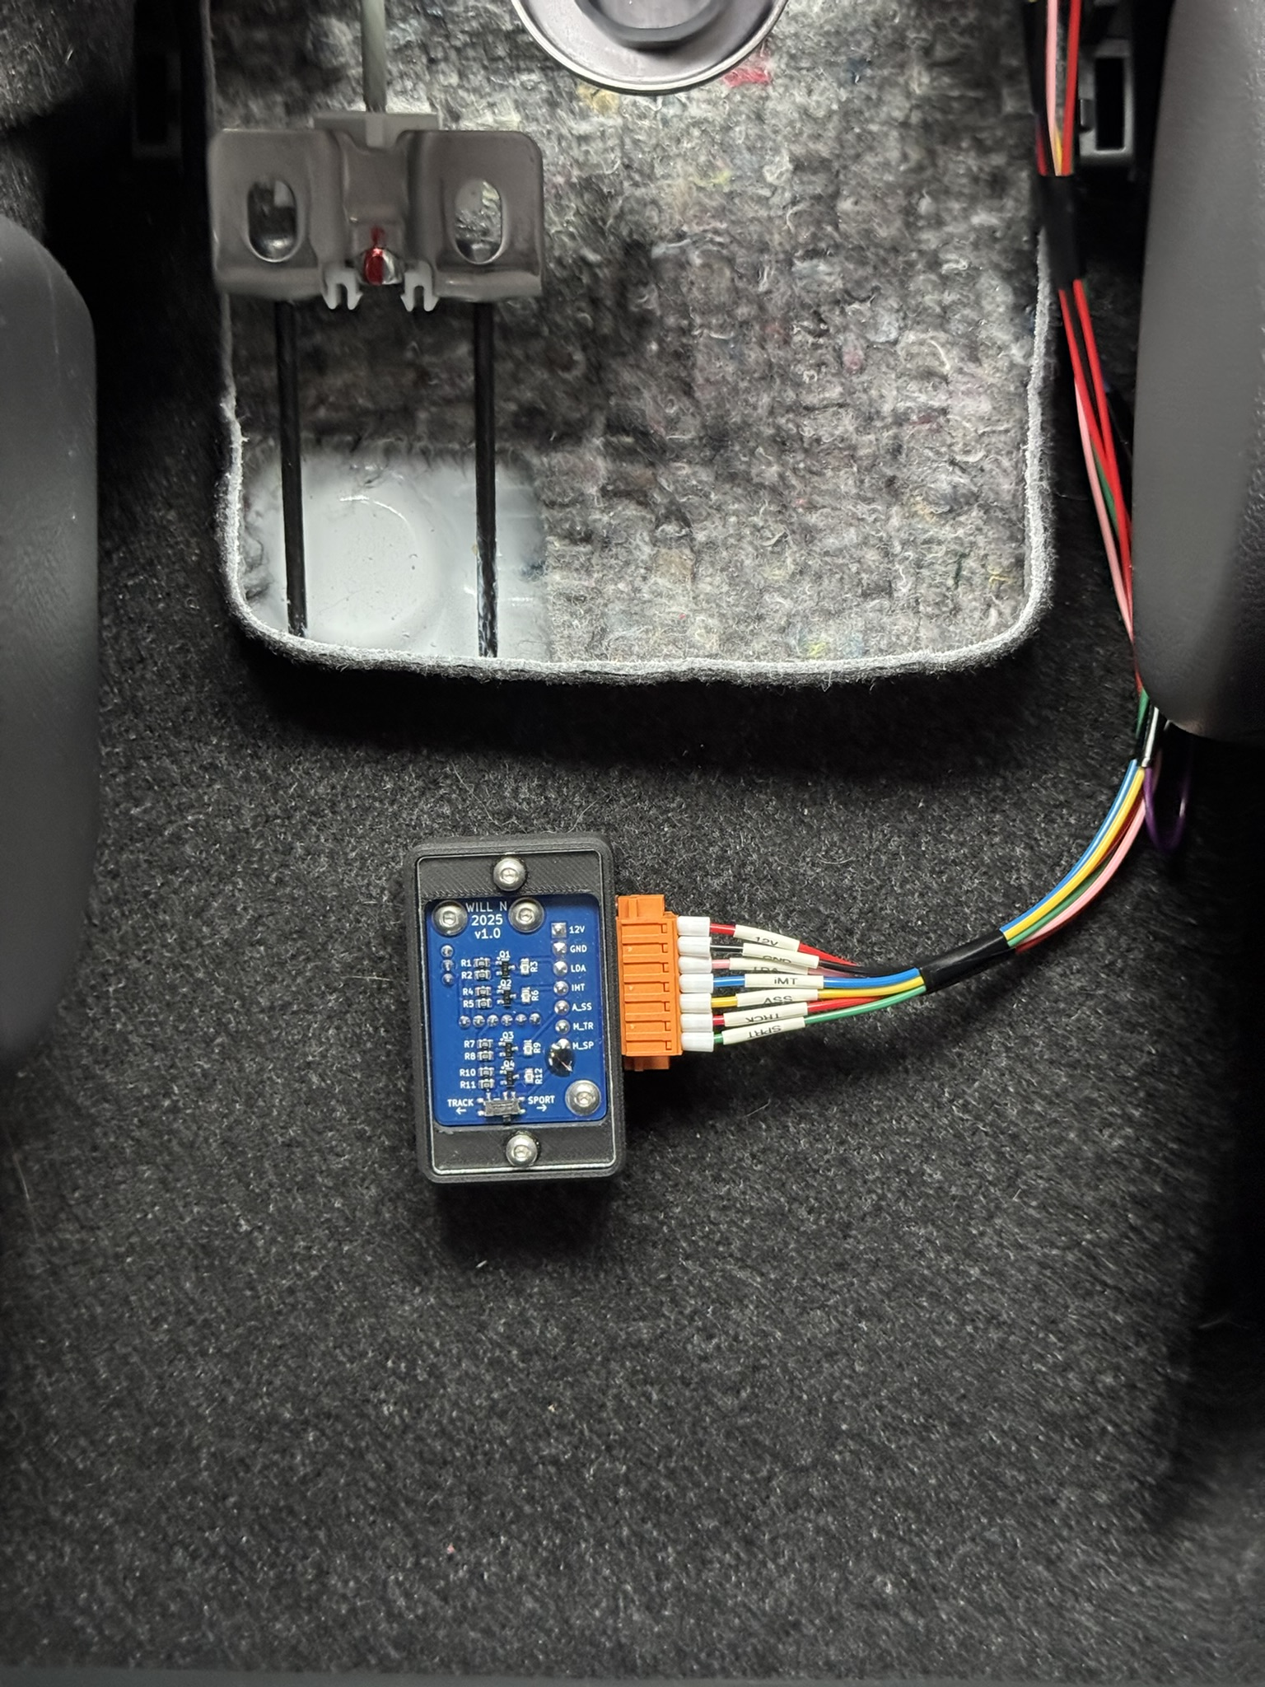
GR Yaris Startup Controller V1.0
Overview & Installation guide
I TAKE NO RESPONSIBILITY FOR ANY DAMAGE CAUSED DURING THE INSTALLATION OR OPERATION OF THE DEVICE.
INSTALL AT YOUR OWN RISK
Rev | Description | Date updated
2 | Install guide updated | 23/03/25
WILLN on GR-Yaris.co.uk
will.norman@sky.com

Slide 2
2. Overview - Operation
Every time the car ignition powers on, the “GR Yaris Startup Controller” turns on and automatically:
Switches off the lane departure alert
Switches off auto stop/start
Switches on iMT
Selects the driving mode (sport/track)
It does this by simply mimicking button presses electronically. If you don’t want all the buttons pressed, wire only the ones you desire and leave the rest empty (i.e., wire in lane departure alert and leave the rest unconnected)
If you don’t feel comfortable splicing into the factory wiring (like me), you can buy short extension harnesses that plug inline, allowing you to splice in without cutting into the factory wires. See links on subsequent slides for where to purchase these extensions.
Notes:
**Be aware that the car will remember some selections if switched back on very shortly after being turned off. As the controller will have restarted on the ignition power cycle, it will ‘press’ all the buttons as intended. As the car will already have the desired modes selected, these additional button presses will toggle them back into the undesired states.

Slide 3
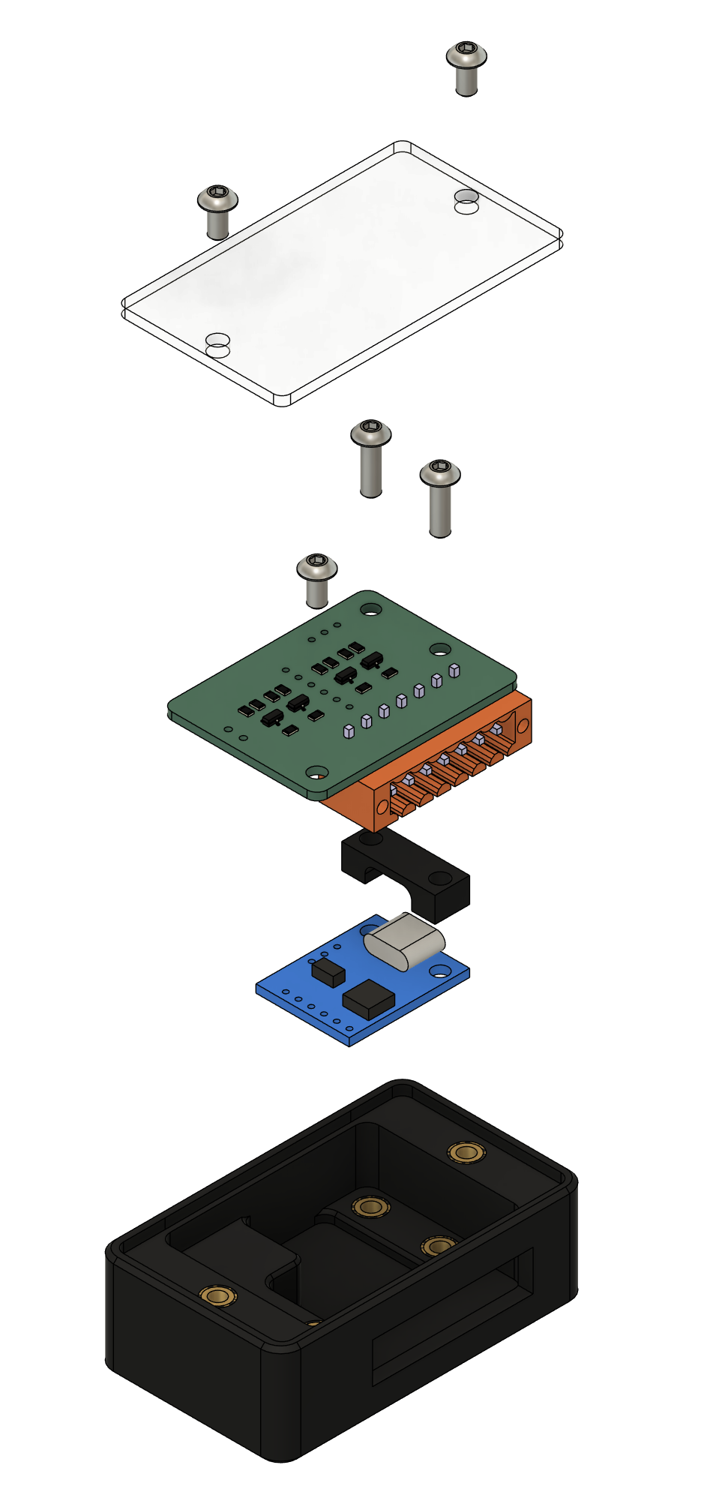
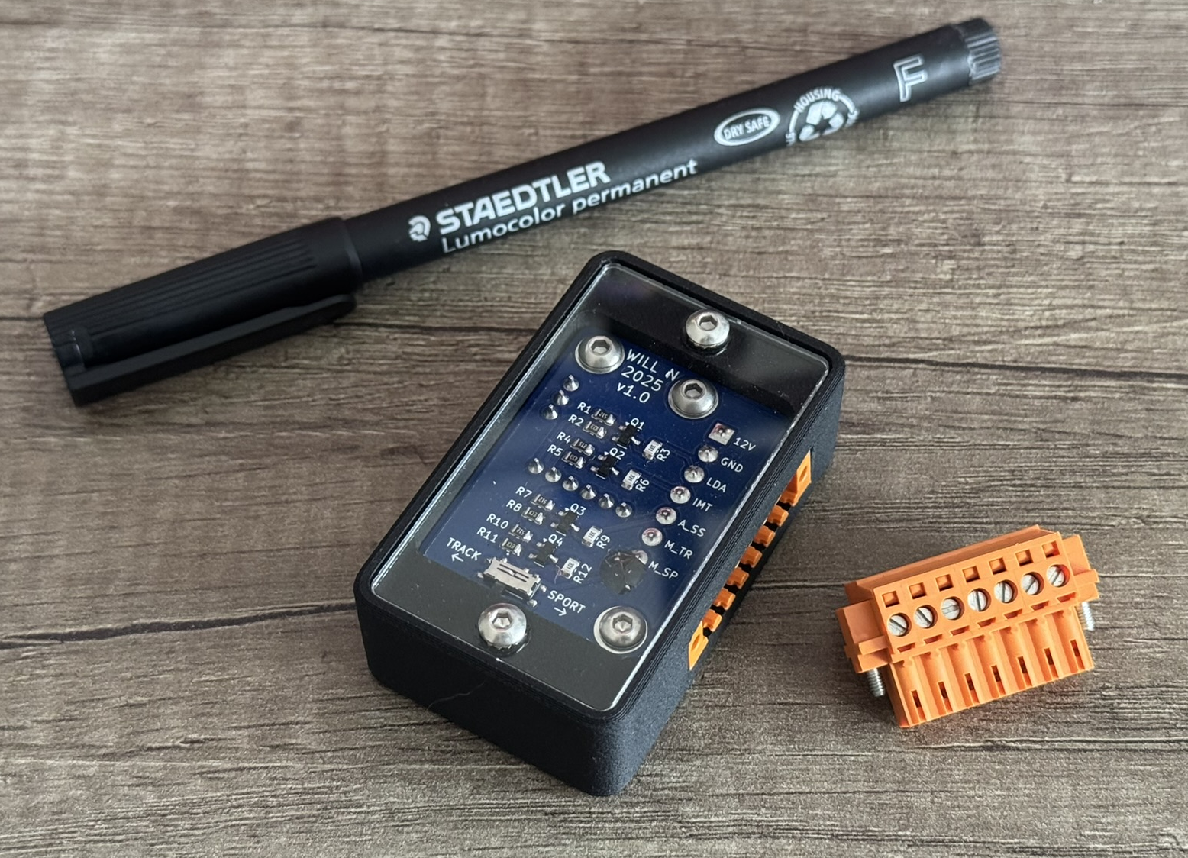
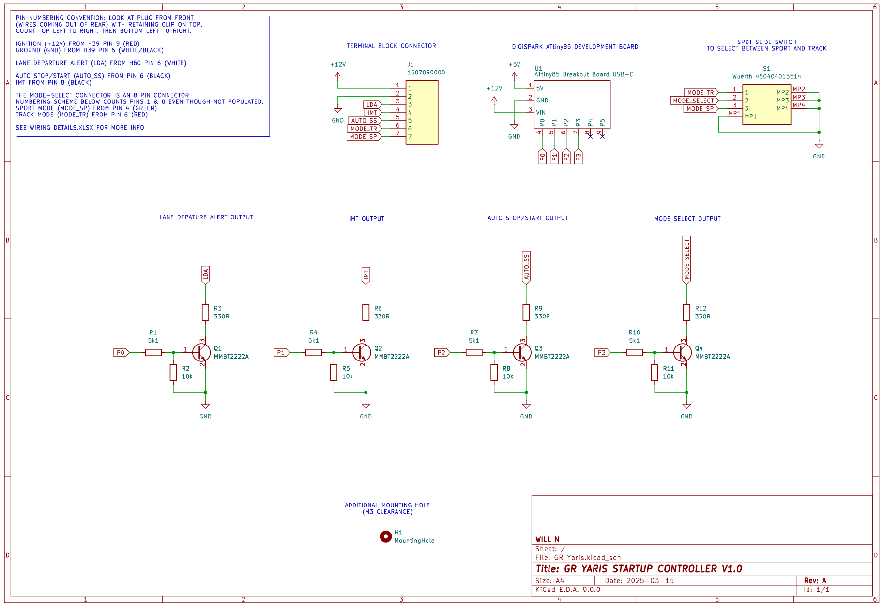
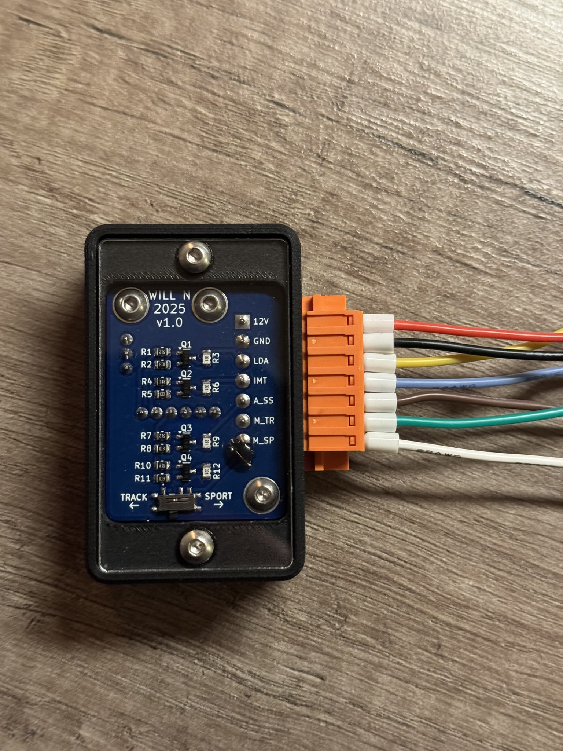
3. Overview - Design
2x M3x6
Cover
2x M3x12
M3x6
Custom PCB
Spacer
ATtiny85 dev board
Housing
Track / Sport switch

Slide 4
4. Controller Wiring
1. +12V (Ignition)^
See page 5
2. GND^
3. LANE DEPARTURE ALERT*
See page 6
4. iMT*
See page 7
5. AUTO STOP / START*
6. TRACK MODE*
See page 8
7. SPORT MODE*
^mandatory
*optional

Slide 5
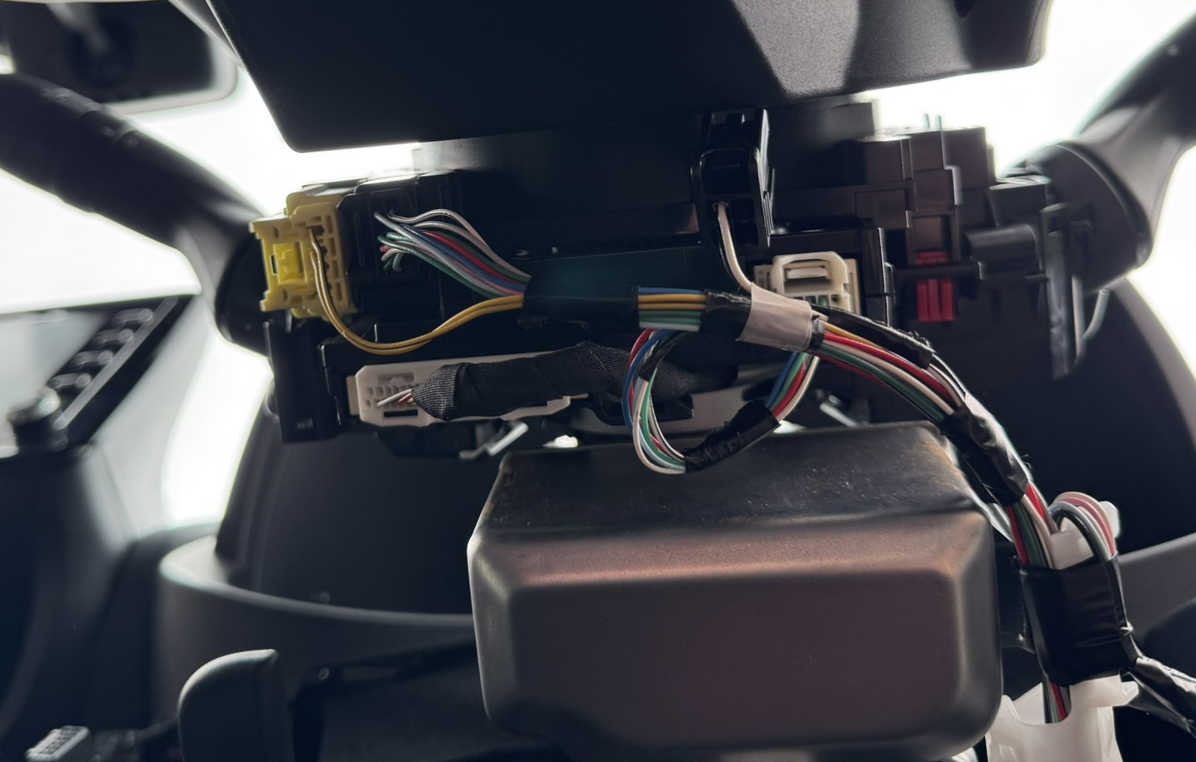
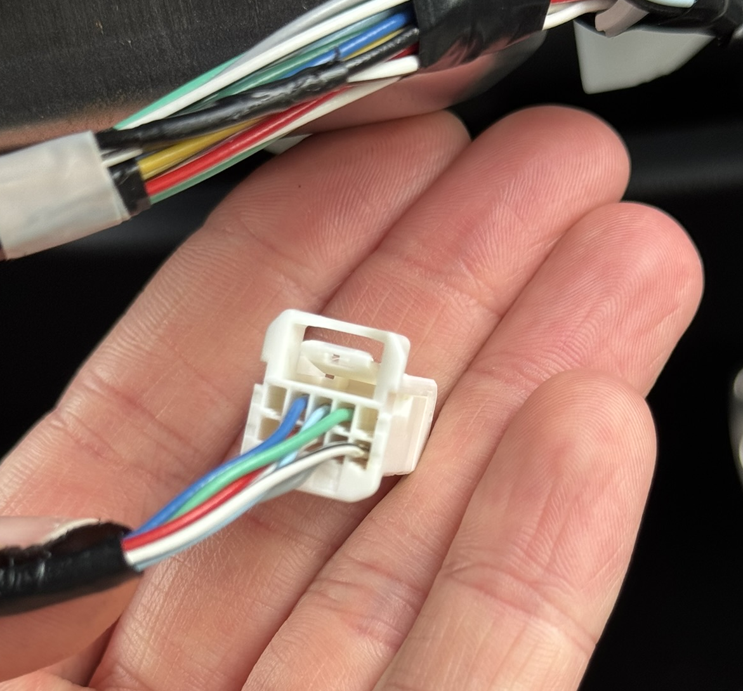
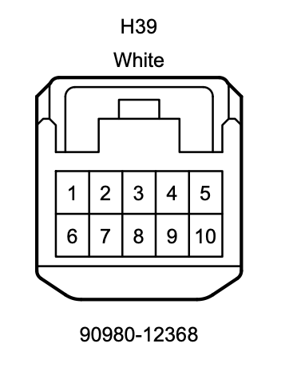
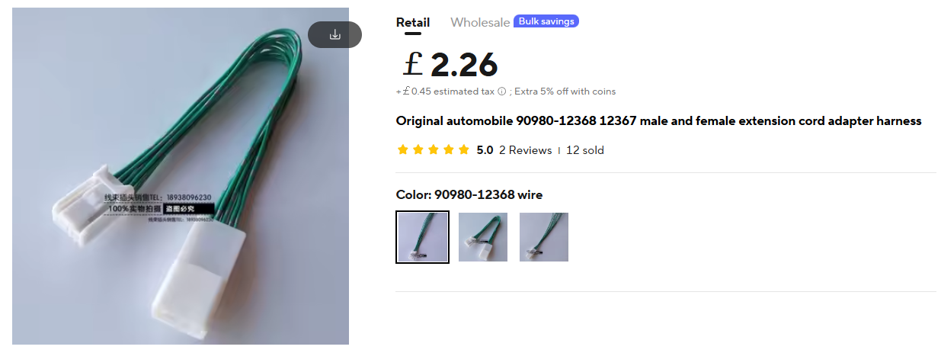
5. Ignition Power + Ground
The wiring for +12V, GND is found under the steering wheel cowling. The cowling is removed by undoing 3x screws.
(Rotate the steering wheel to reveal 2 hidden screws)
+12V (Ignition) and Ground are taken from the 10-pin connector (H39):
Pin number 9 (Red) = +12V (Ignition)
Pin number 6 (White & black stripe) = Ground
If you don’t want to splice into the factory wiring, short extension harnesses can be purchased here that you can modify:
10-pin extension harness
Another option that should work

Slide 6
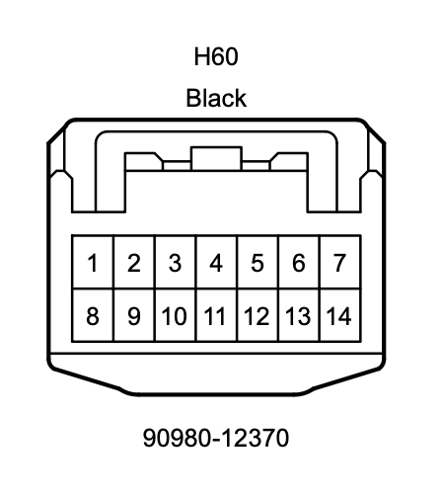
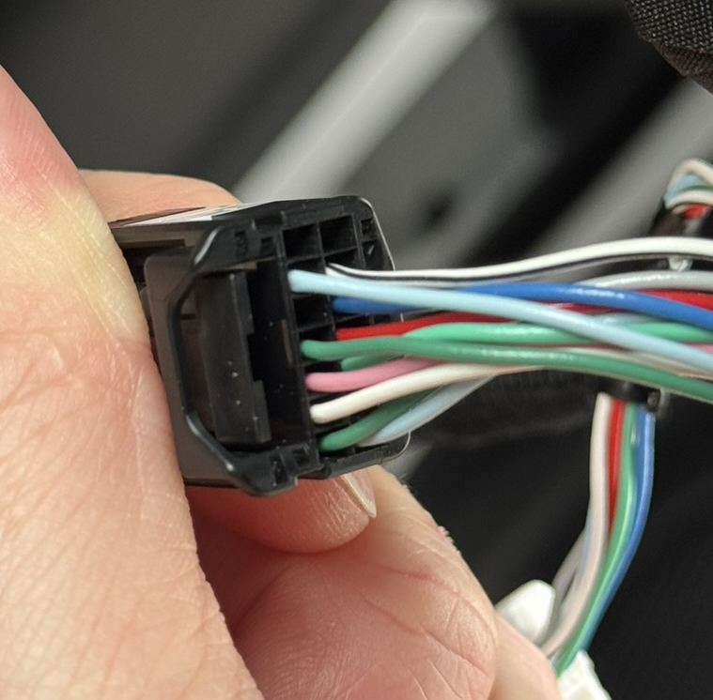
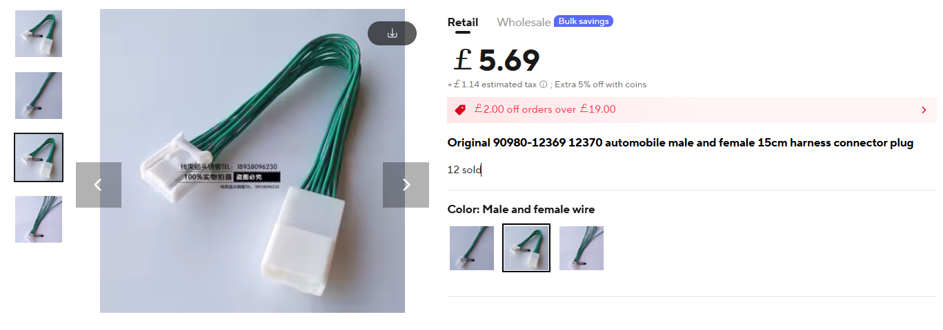
6. Lane Departure Alert
The wiring for LDA is also found under the steering wheel cowling
LDA is taken from the 14-pin connector (H60):
Pin number 6 (White) = Lane Departure Alert (LDA)
If you don’t want to splice into the factory wiring, short extension harnesses can be purchased here that you can modify:
14-pin extension harness

Slide 7
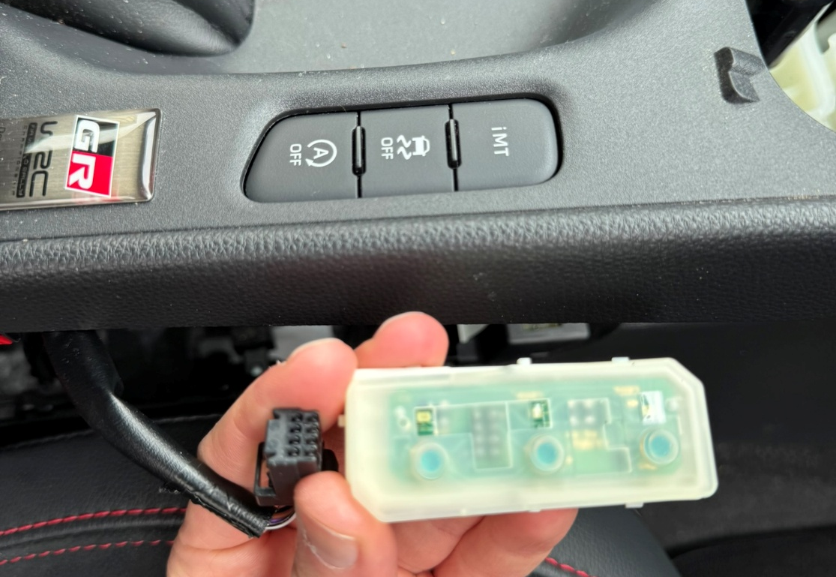
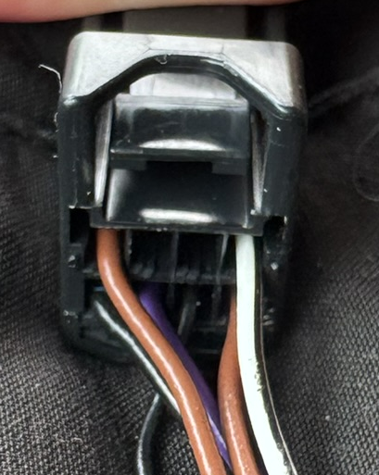
7. iMT & Auto Stop/Start
The wiring loom needed for iMT and Auto Stop/Start is found under the centre console
(plugged into the iMT/ESP/Auto stop start multi-button)
iMT and Auto Stop/Start are both found on the 8-pin connector that plugs into the button unit:
Pin number 8 (Black) = iMT
Pin number 6 (Black) = Auto stop/start
4
3
2
1
8
7
6
5
This 8-pin connector is:
Plug: Tokai Rika 4A1330-000 (Toyota 90980-12910)
Socket: Tokai Rika 4B1160-000
A supplier is yet to be found…

Slide 8
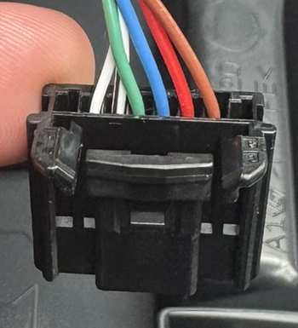
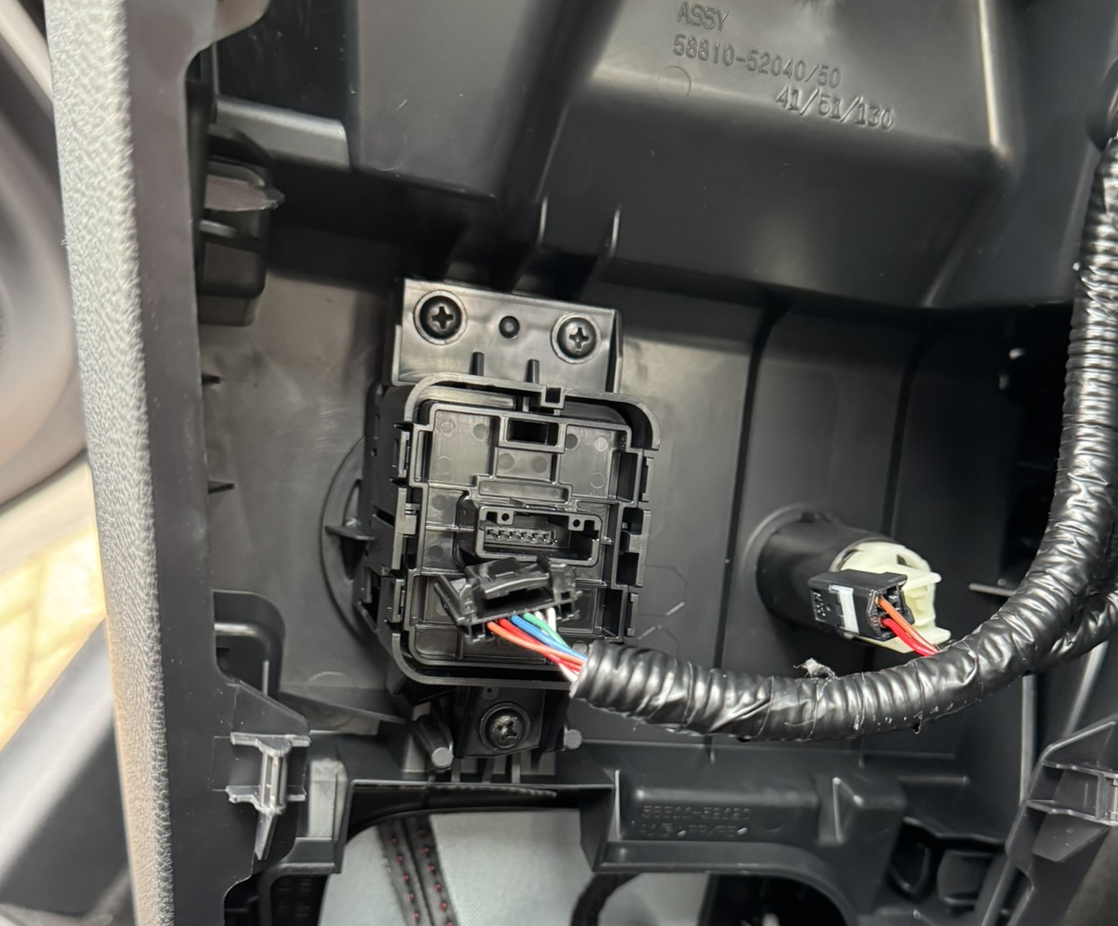
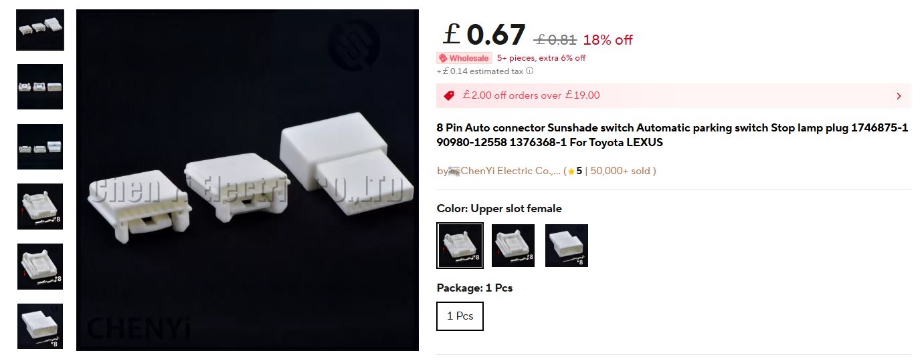
8. Driving Mode – Sport / Track
The wiring loom needed for Sport/Track mode select is found under the centre console
(plugged into the drive mode rotary button)
Sport and Track mode are both found in the 8-pin connector that plugs into the drive mode rotary button.
(Note pins 1 and 8 are empty in the plug but still counted here):
Pin number 4 (Green) = Sport
Pin number 6 (Red) = Track
You can wire both sport and track into the controller and use the slide switch on the PCB to choose between them. The slide switch must be in the appropriate position if you decide to wire only Sport or Track.
If you don’t want to splice into the factory wiring, a short extension harness can be made up using these connectors:
8-pin plug + socket + crimp pins
(choose the “Upper slot female” version)
1
2
3
4
5
6
7
8

Slide 9
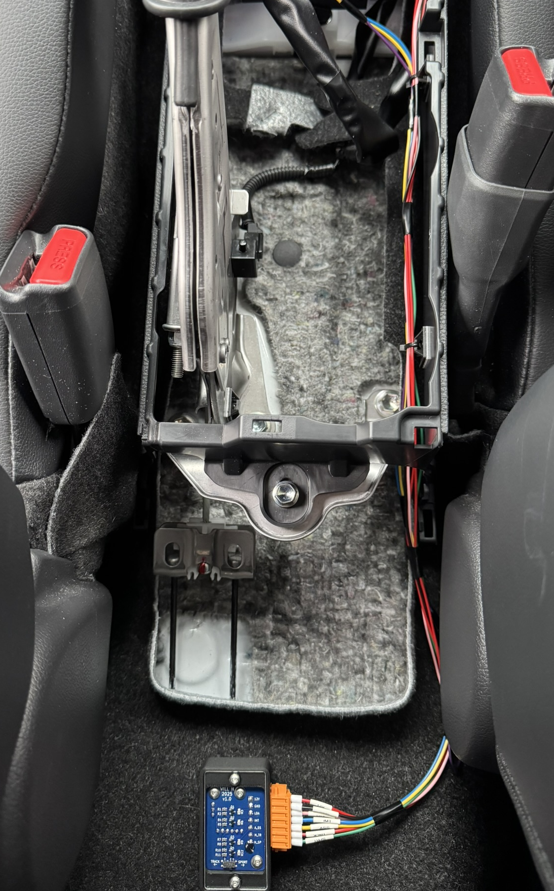
9. Helpful Links
Project files and information on GitHub
Link to forum post where idea initially discussed by MagnusT
How to pull apart the centre console
22 AWG wire
Ferrule crimp kit

Slide 10
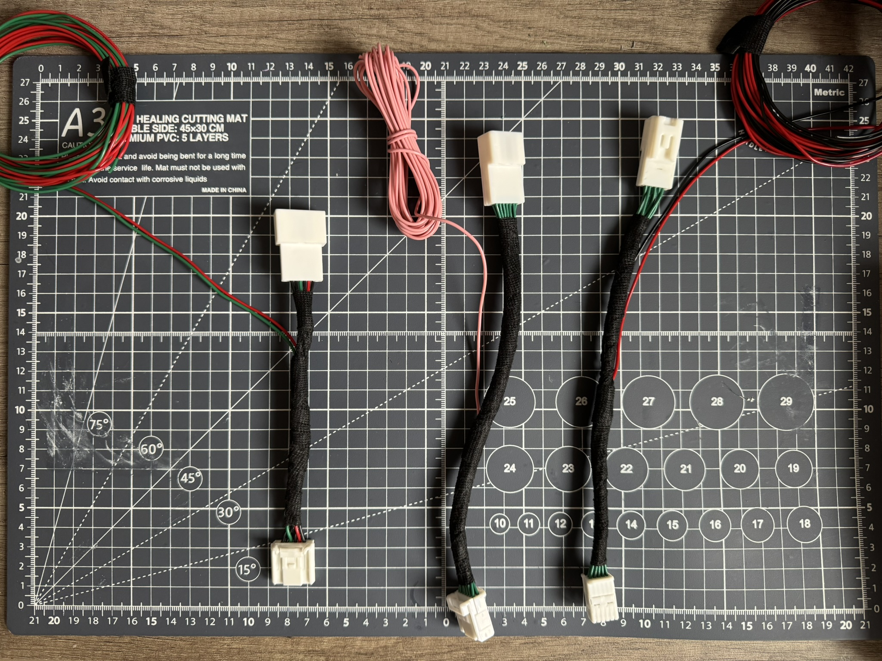
10. Extension Harnesses
Power & Ground Options
10-pin extension harness
Another 10-pin option that should work
Lane Departure Alert: 14-pin extension harness
Sport/Track Mode: 8-pin plug + socket + crimp pins (upper slot female)
iMT/ESP/Auto Stop Start: 8-pin **Yet to be found**
3
1
2

